Slide 1
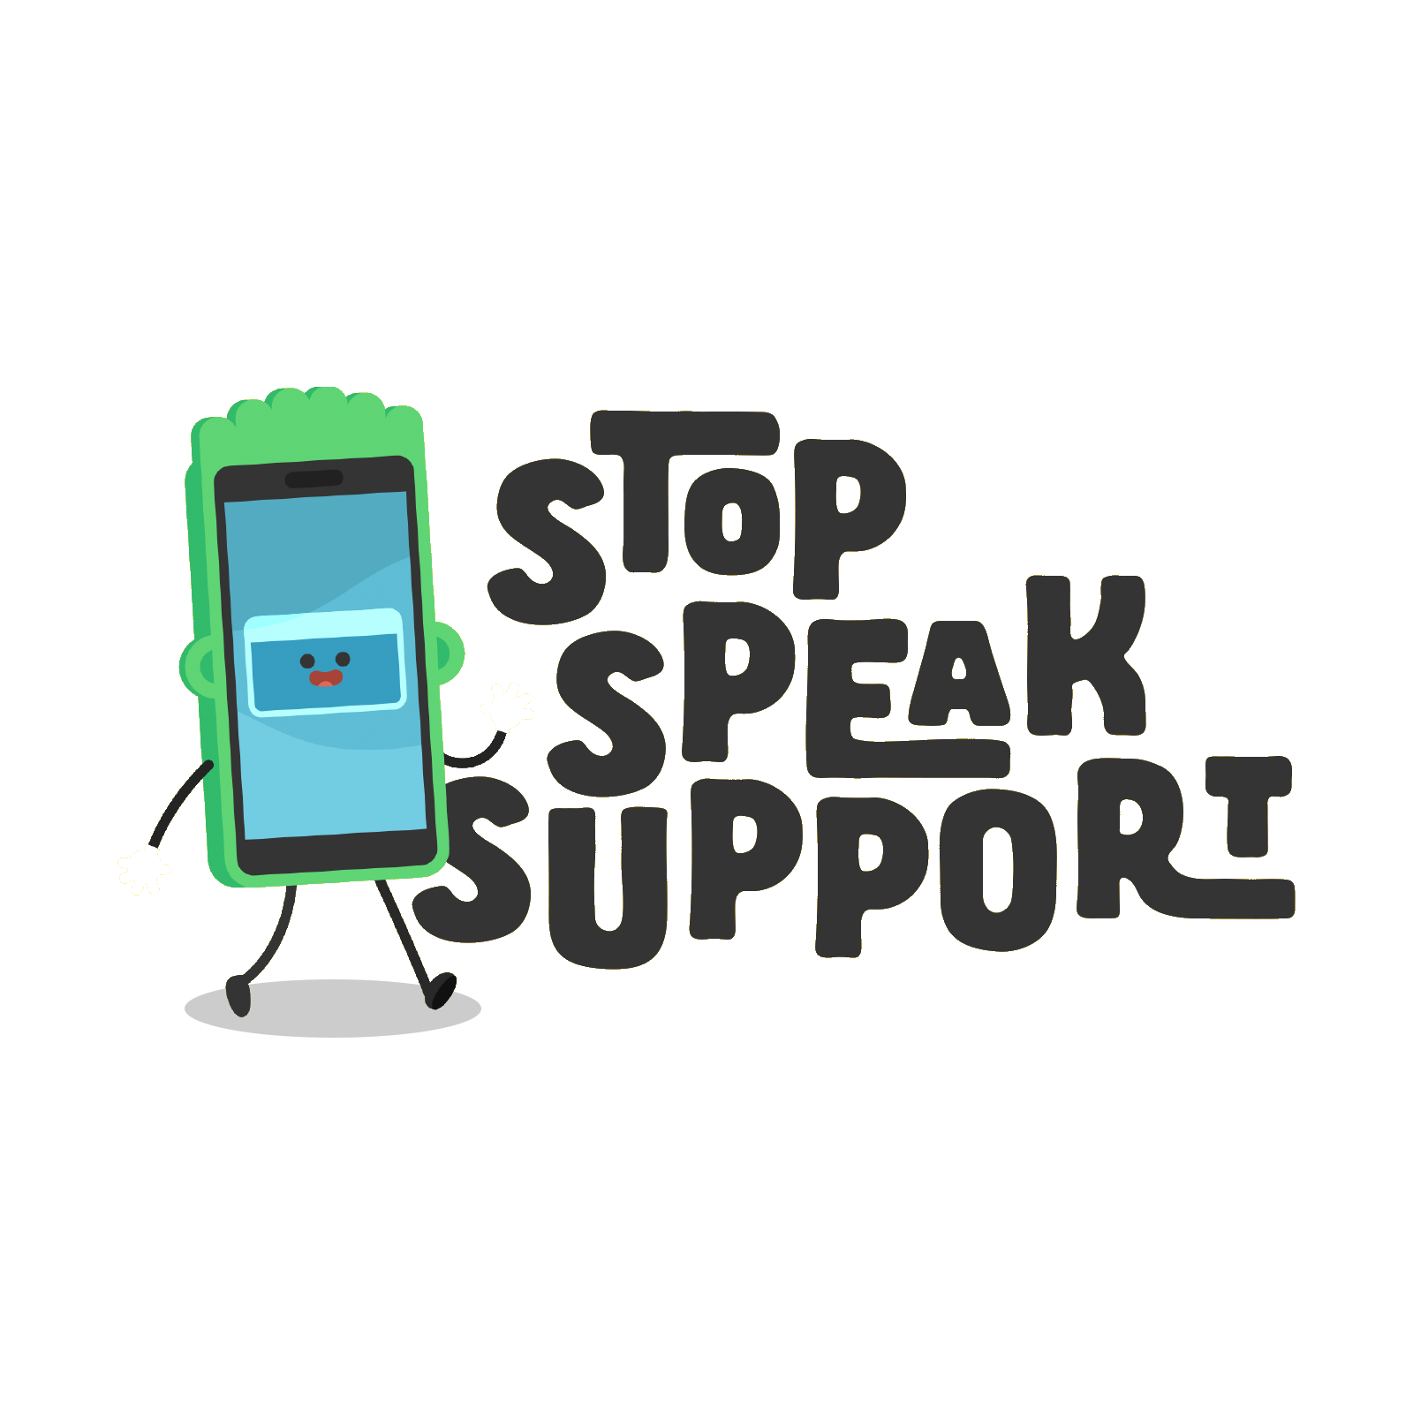
Why are we focusing on cyber bullying (again)?

Slide 2
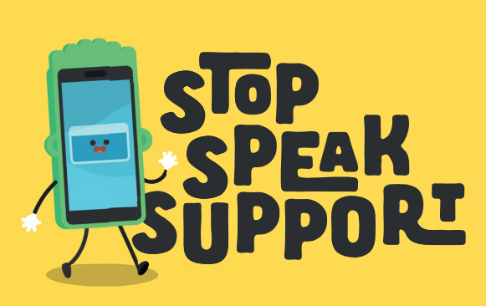

Slide 3
Stop Speak Support Day
for Anti-Bullying Week 2018:
St Ninian’s High School
Notes:
Opening comments:
When introducing yourself please make sure to say that you are delivering this session on behalf of the Anti-bullying alliance.
This is an interactive workshop and I would be happy for you to ask relevant questions as we go along.
Housekeeping: Detail any housekeeping arrangements including breaks, fire safety, toilets/washrooms, etc.
(This training is certified CPD training. Delegates can have a certificate but they must check off on the list that they have attended. Within 6 weeks they will receive a certificate of attendance via email for their records. Please can they not down their email if it is not accurate)
At our Training the Trainers session, the question of language came up several times. We agreed that we would not refer to pupils, students, etc but rather to Children and Young People shortened in writing to CYP.
In addition we discussed why it is more acceptable to refer to “disabled people” rather than “people with disabilities”. As you know, the Social Model regards disability as something imposed on top of an individual’s impairments by the way they are unnecessarily excluded and marginalised from society. For example this might be through lack of physical access or through prejudicial attitudes and discrimination.
Dr Colin Cameron is a senior lecturer in Disability Studies at Northumbria University, Newcastle upon Tyne. He states that:
“Whether we have physical, sensory, emotional or cognitive impairments, as disabled people we have a right to regard these as being a core part of what makes us who we are, not as something to distance ourselves from or be ashamed about. While impairment can sometimes be nasty, messy, painful, and certainly isn’t all we are about, it is a big part of us. It needs to be recognised, affirmed and included on that basis. It isn’t our bodies that we need to be angry at, but the treatment dished out to people with impairments in a disabling society. “

Slide 4
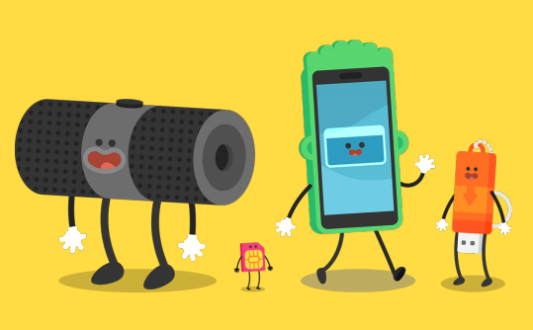
1 in 5 teenagers in England have experienced cyber bullying in the last 2 months
Children who are cyber bullied are more likely to become anxious depressed or lonely

Slide 5
The ‘Stop Speak Support’ Code of Conduct has been developed with young people
It aims to provide simple steps that anyone who witnesses cyber bullying can follow

Slide 6
Don’t be a bystander in cyber bullying – we all have a role to play
STOP, SPEAK, SUPPORT!
Video

Slide 7
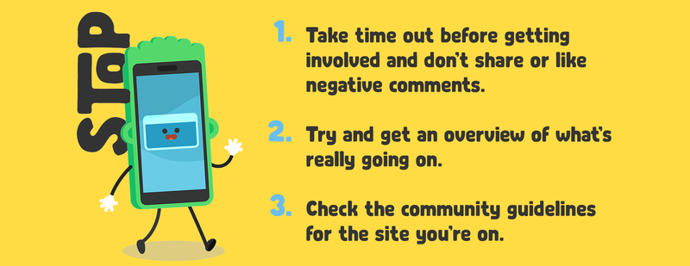

Slide 8
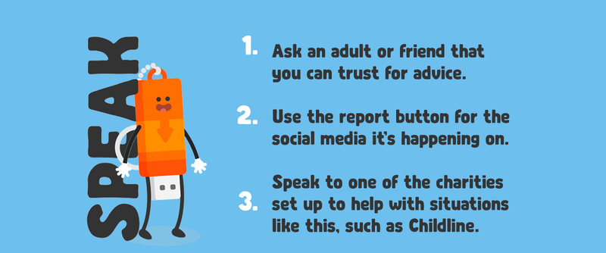

Slide 9
